Slide 1
Hackcav’18 organised by iiit kottayam and rolta foundation kit-kalaignarkarunanidhi institute of technology
TEAM MEMBERS
GOWTHAMI R (711515106026)
AARTHI K (711515106301)
MICHAEL SELVA AJITH A (711515106053)
DEEPAK M (711515106015)
Guide Name:
Mr.R.GOWRISHANKAR

Slide 2

TITLE
WINDOW GRIDS & FLOOR CLEANER WITH HI-FI CHARGER

Slide 3
CONTENTS
1. Objective
2. Literature Survey
3. Existing Method
4. Proposed Method
5. Cost Estimate
6. Modules
7. Block Diagram
8. Charger Module

Slide 4
OBJECTIVE
The objective is to develop a product for cleaning the window and its grids with compact and easy design. The product also has the hi-fi charger that automatically switches off power supply when the battery gets fully charged.

Slide 5
LITERATURE SURVEY
TITLE: Design and manufacture of a pneumatic glass climbing robot for cleaning of High-Rise buildings.
AUTHOR: Hashem Anwari and Nidhal Abdulaziz
DOI: IEEE 2011
TITLE: Design and Development of Glass Cleaning Robot.
AUTHOR: Luo Yiwen, Er Meng Joo, Ong Lok Ping
DOI: IEEE 2013

Slide 6
SURVEY OF EXISTING METHOD
In existing system, robot is used for cleaning the window. The glass climbing robot for cleaning window is used in high rise building. The robots will stick to the window glass and clean automatically.
The existing system for mobile charger is that it does not stop the power supply when the battery gets fully charged. So, it leads to power loss and also affects the battery life.

Slide 7
PROPOSED METHOD
Utilization of the proposed system will be easy in cleaning the window grids and floor which is also cost effective. This can be used for other purpose like cleaning the book shelf, table and all other small, medium and bigger areas. So it reduces man power.
And the provision of smart charger to switch off power supply when battery gets fully charged and to provide some protection circuits to protect the system and its battery

Slide 8
COST ESTIMATE
S.NO | REQUIREMENT | QUANTITY | COST
1 | Hot Air Blower | 1 | RS 1300
2 | Sponge | 1 | RS 700
3 | Motor | 1 | RS 800
4 | Handler | 1 | RS 400
5 | Controller unit | 1 | RS 1500
6 | Water &Air tube | 1 | RS 650
7 | Floor cleaning unit | 1 | RS 1000

Slide 9
S.NO | REQUIREMENTS | QUANTITY | COST
8 | Flexible Rod | 1 | RS 600
9 | Sponge holder & Rotator | 1 | RS 500
10 | Voltage and Current sensing module | 2 | RS 650
11 | Controller unit | 1 | RS 2400
12 | Charging units | 1 | RS 700
13 | Rechargeable battery | 1 | RS 800
14 | Power supply unit and Holding caps | 2 | RS 1100
15 | Workshops and seminars |  | RS 1000
16 | Documentation | 2 | RS 1000
 | TOTAL ESTIMATE |  | RS 15100

Slide 10
MODULES
S.NO | MODULES | DURATION
1 | Controller unit for Cleaner | 2 Months
2 | Controller unit for Charger | 3 Months
3 | Assembling of Cleaner | 2 Months
4 | Assembling of Charger | 1 Month
5 | Finishing & Checking | 1 Week

Slide 11
MODULE DESCRIPTION
1. Controller unit for cleaner:
Microcontroller controls the operations of air blower, water sprinkler, rotation of motor and it also controls the floor cleaning unit and power supply unit.
2. Controller unit for charger:
Microcontroller sense the ac voltage, frequency range and detects the system to be charged and its battery percentage and allow the required current for the battery to control and protect the charging unit. It turns ON and OFF the power supply for the charger according to the high and low voltage, short circuit and fully charging condition.

Slide 12
MODULE DESCRIPTION
3. Assembling of cleaner:
Assembling the components of the cleaner like sponge,water sprinkler, air blower,power supply unit, handler and flexible rod.
4. Assembling of charger:
Assembling the components of charger like controller,charging units, power supply unit, protection circuits,current and voltage sensing and drive circuits.
5. Finishing and Checking:
Checking the working of window girds cleaner and charger in various situations and altering the product according to its operations

Slide 13
BLOCK DIAGRAM
Voltage &current sensor
Micro controller
atmega328p
I2C Interface
AC Power Supply
Relay Circuit
Charging Module (SMPS)
Protection&
Charging monitoring module
For Cleaner as well as Mobile Charger

Slide 14
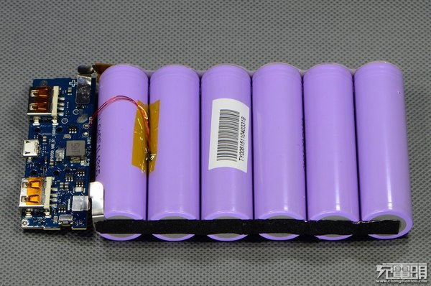
CHaRGER MODULE

Slide 15
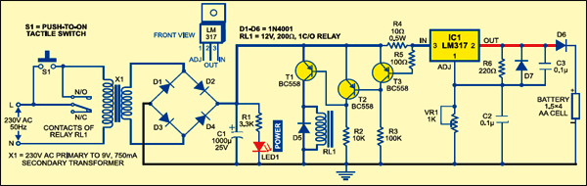
AUTOMATIC TURN OFF CHARGER

Slide 16
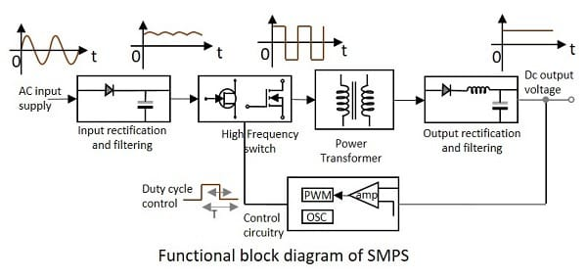
SMPS- BLOCK DIAGRAM

Slide 17
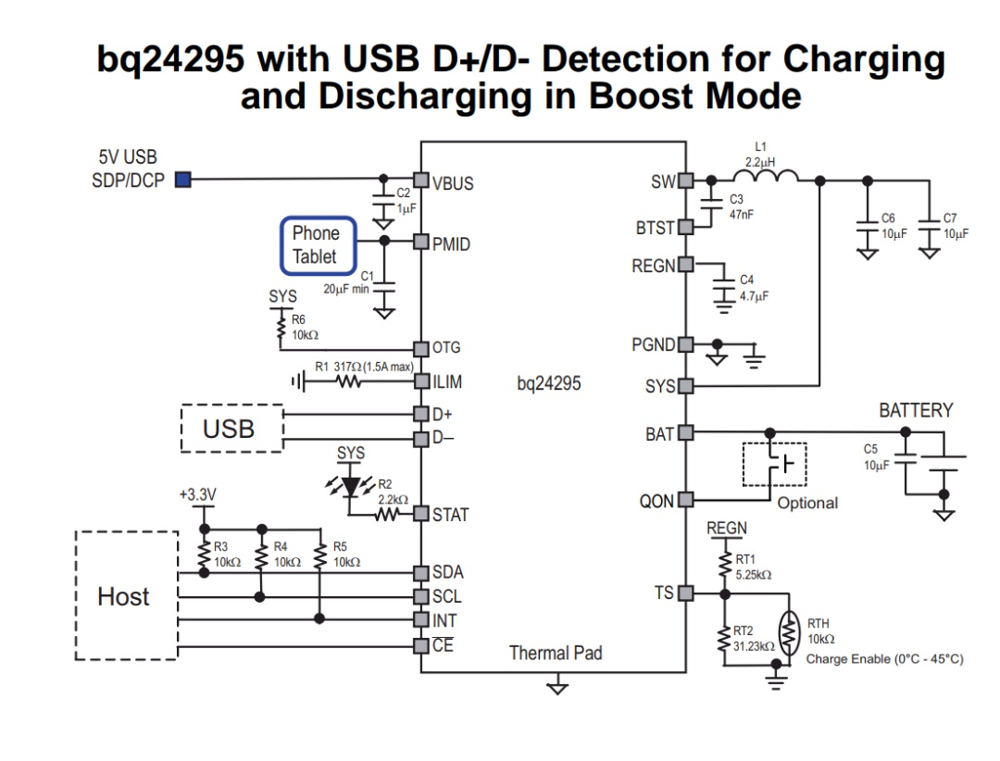

Slide 18
Software & HARDWARE tools
Arduino IDE-1.8.7
AVRDUDESS
Li-Ion battery
Atmega328p
Bq24295
Relay
Smps converter
Voltage & Current sensor

Slide 19
FUTURE SCOPE
This product is cost effective and user friendly to the people of the society.
Window Grids Cleaner is easy to carry from one place to another and it is easy to use as well as flexible.
HI-FI charger is also portable and provide a new way of charging scheme to the people.
So, this product will be useful for people as it reduces their time to clean the windows and will be helpful in keeping the house clean, tidy and it will create a great impact to the society

Slide 20
REVIEW..........

